Slide 1
CSE 2202 Design and Analysis of Algorithms – I Lecture 10 Divide and Conquer - II
Hasnain Heickal
Assistant Professor
Department of CSE, University of Dhaka

Slide 2
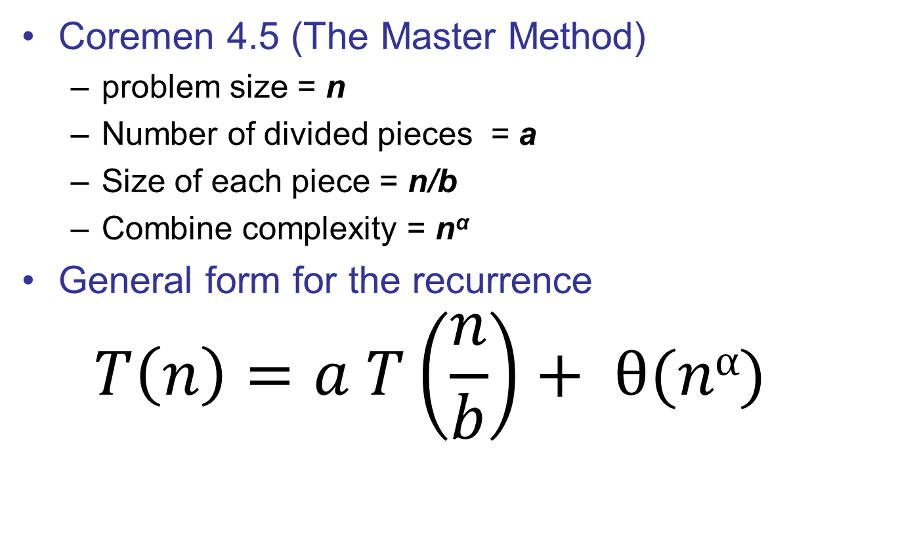
General Formula for D&C
Coremen 4.5 (The Master Method)
problem size = n
Number of divided pieces = a
Size of each piece = n/b
Combine complexity = n^{α}
General form for the recurrence
$$T\left(n\right)=a T\left(\frac{n}{b}\right)+ θ(nα)$$

Slide 3
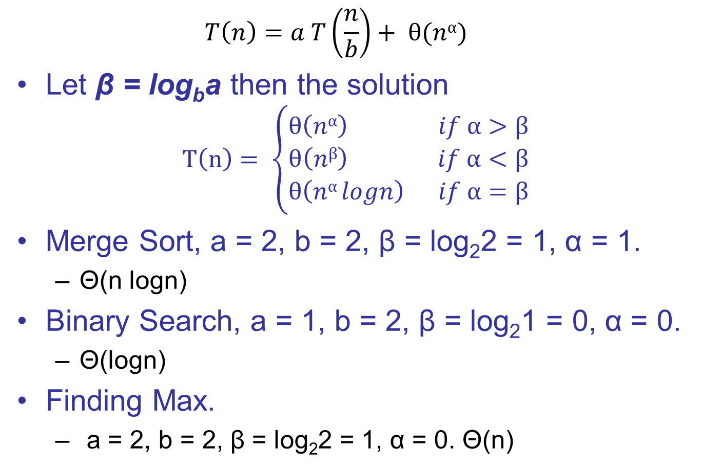
General Formula for D&C
$$T\left(n\right)=a T\left(\frac{n}{b}\right)+ θ(nα)$$
Let β = log_{b}a then the solution
$$T\left(n\right)= \left\{\begin{aligned}θ\left(nα\right) if α>β \\ θ\left(nβ\right) if α<β \\ θ\left(nα logn\right) if α=β\end{aligned}\right.$$
Merge Sort, a = 2, b = 2, β = log₂2 = 1, α = 1.
Θ(n logn)
Binary Search, a = 1, b = 2, β = log₂1 = 0, α = 0.
Θ(logn)
Finding Max.
a = 2, b = 2, β = log₂2 = 1, α = 0. Θ(n)

Slide 4
Ternary Search
Problem
Two person moving together in constant speed, what is the closest, they will come.
Analysis
a
b
alpha
beta
Complexity

Slide 5
Multiplying two n-bit numbers
Naïve approach
Θ(n²)
Divide and conquer approach
Divide each integer into two halves of n/2 bits each
A = A₁2^{n/2} + A₂
B = B₁2^{n/2} + B₂
A x B = (A₁B₁)2^{n} + (A₁B₂ + A₂B₁)2^{n/2} + A₂B₂
So the original problem is divided into 4 sub-problems each with size n/2
Combining requires O(n), since it can be done using addition and bit shift.

Slide 6

Multiplying two n-bit numbers
$T\left(n\right)=a T\left(\frac{n}{b}\right)+ θ(nα)$, β = log_{b}a
$$T\left(n\right)= \left\{\begin{aligned}θ\left(nα\right) if α>β \\ θ\left(nβ\right) if α<β \\ θ\left(nα logn\right) if α=β\end{aligned}\right.$$
a = 4, b = 2, α = 1, β = log₂4 = 2
T(n) = θ(n²)

Slide 7
Multiplying two n-bit numbers Alternate Way
P₁ = A₁B₁
P₂ = A₂B₂
P₃ = (A₁ + A₂)(B₁ + B₂)
A x B = P₁2^{n} + (P₃ – P₁ – P₂)2^{n/2} + P₂
So now we have reduced the number of sub-problems to 3.
As a = 3, b = 2, α = 1, β = log₂3 = 1.59
T(n) = θ(n^{1.59})

Slide 8
Read at your own
Strassen’s Amazing Matrix Multiplication Algorithm.
Coremen 4.2

